Slide 1
A
Wave Bioreactor
BIO SUMMIT 4.0
SynBiosys
SBGH
Synthetic Biosystems Global Hub
October 10th, 2020
Adrian Filips (Ottawa Bio Science, Ottawa Canada)
David J. Castillo (Glyxon Biolabs, Mexico City, Mexico) Alex Klenov (PipetteJockey, Toronto, Canada) Alexander Yakovlev (Ottawa Bio Science, Ottawa, Canada) And many more volunteer collaborators…
+
+
+
many more
http://specyal.com/diybio/bioreactor.html
1

Slide 2
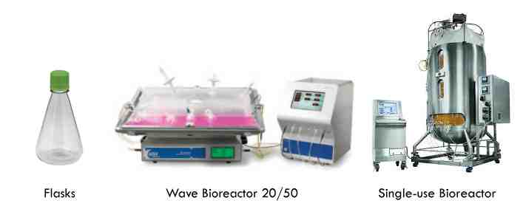
A
What is a Bioreactor? & Why do you need it?
A Bioreactor is a “vessel” that can isolate and control the environmental
conditions to optimize and manipulate the growth and metabolism of cells and tissues.
Basically a controlled environment growth chamber or a flask on steroids!

Slide 3
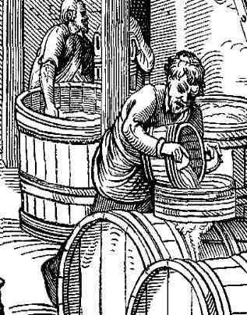
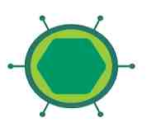
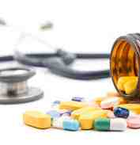
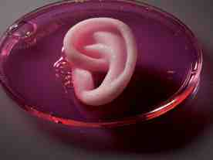
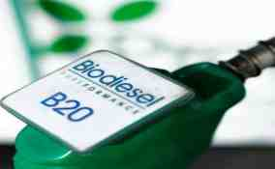
Bioreactors have been a quintessential in biology since the dawn of times and evolved in the present
A
Bioreactors can be anything from an old Greek wine crater to a microfluidic chip or
Hectolitre industrial setup.
Antibiotics
Viral Vectors for in-vivo genetic editing
Food & Beverages
Traditional Biotechnology:
Winery, Cheese and Bread, kombucha, natto.
The Future?
Biofuels &
Biomaterials
Pharma
Tissue engineering
& regenerative medicine
Antimicrobials, growth factors, vaccines
Energy Alternatives to fossil fuels
Compatible biomaterials, scaffolds, fillers, growth media.

Slide 4
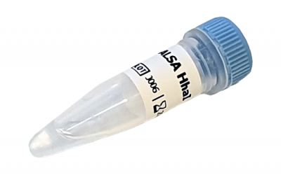
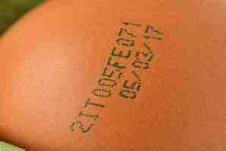
A
Project aims and Justification
Why a bioreactor is a must have for DIYBio?
Acquiring molecular reagents is the greatest challenge stopping you from performing
projects
Molecular reagents are consumables that sometimes make up the largest cost of experiments
Molecular reagents are often denied to smaller or personal labs
Molecular Reagents have a limited shelf-life, require frequent restocking
Expensive supply chains: Reagents like enzymes need to be shipped on dry ice
There are multiple importation and international distribution restrictions
6

Slide 5
A
Project aims and Justification
We want this!, plenty, easy, cheaply, quickly!…
7

Slide 6
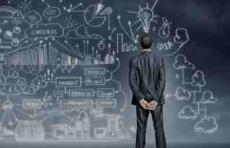
D
Phase 1
ASSESSMENT What challenges an affordable Bioreactor faces?
-COST: It has to be AFFORDABLE to a small lab. We target under 500$.
Has to recover the cost in several months or several experiments. For instance, if you need RT and a polymerase to create a SARS-Cov2 detection you should be able to recover the costs in one or two experiments.
-REUSABILITY: Like SpaceX’s rockets, our bioreactor's vessels has to be reusable, autoclaveable or sterizable. -USER FRIENDLY: Ideally an integral solution more than another “gadget". Therefore it should come with organisms (strains), protocols and a full workflow manual and instructions comprising all the steps to the final product.
A large amount of projects integrated together- A rocker, An OD reader, A DO reader, a pH control system, an aeration system, a potentiostat, an orbital shaker etc. Unexpected challenges due to pandemic:
Unavailability of parts and unreliable shipping. Parts that normally took weeks to obtain took longer or never came Denied and delayed access to fabrication equipment due to pandemic business closures.
Regulatory and Biosafety:
Not all countries allow the use, distribution and modification of GMO’s including non-pathogenic bacterial strains, plasmids and, or associated DNA engineering technologies, making technology transference more difficult.
9

Slide 7
A
ACHIEVEMENTS
10

Slide 8
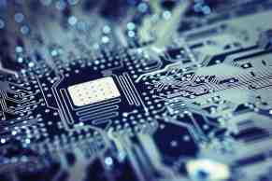
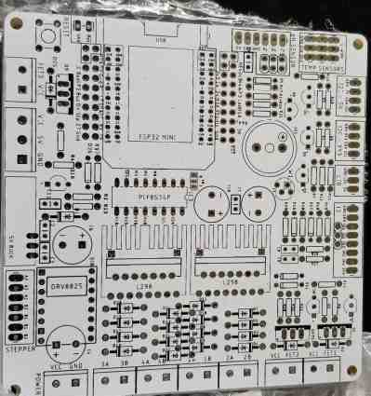
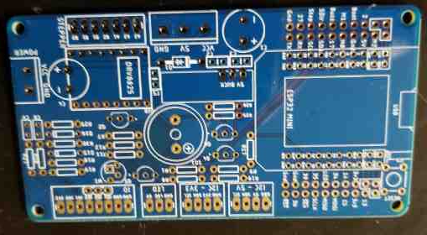
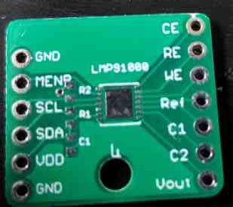
A
Phase 2
ELECTRONICS: PCB design
A) Bioreactor motherboard
B) break-out board for Orbital Shaker
C) Break-out board for potentiostat
(optional DO reader)
11

Slide 9
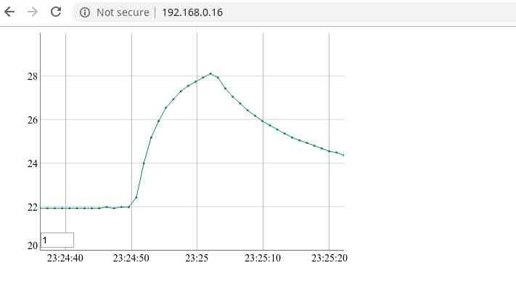
A
Phase 2
SOFTWARE:
User interface using laptop or cell phone via WiFi
Allows for large display, processing power, remote monitoring and actuation and decreases costs. Buzzer for acoustic signals on the device and optional small display (not used now) on the rocker
Uses modern controller with built in WiFi, compatible with Arduino
12

Slide 10
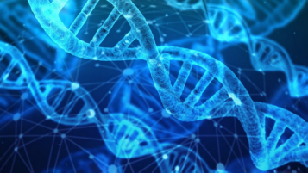
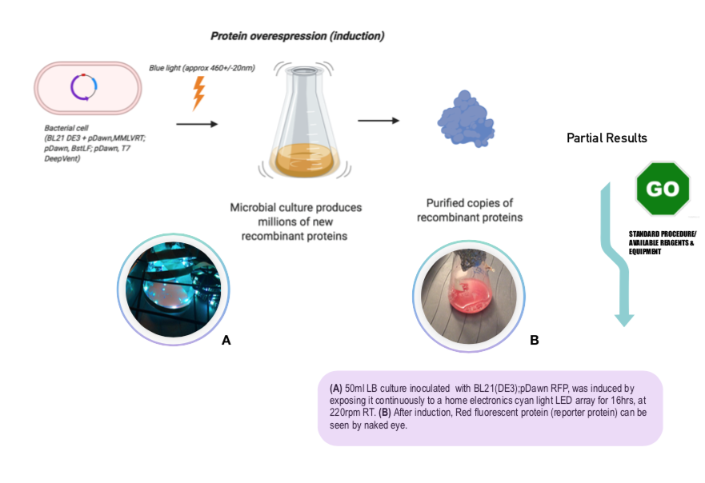
D
Phase 3-II
Optogenetic Molecular Biosynthesis (Proof of concept)
Blue light induced proteins using pDawn plasmids could pave the road to a more refined optogenetic circuitry and regulation to express multiple proteins under different wavelengths.
mCherry (reporter protein)
(David J. Castillo, Glyxon Biolabs 2020)
pDawn chassis: Journal of Molecular Biology · March 2012. DOI: 10.1016/j.jmb.2012.01.001 · Source: PubMed

Slide 11
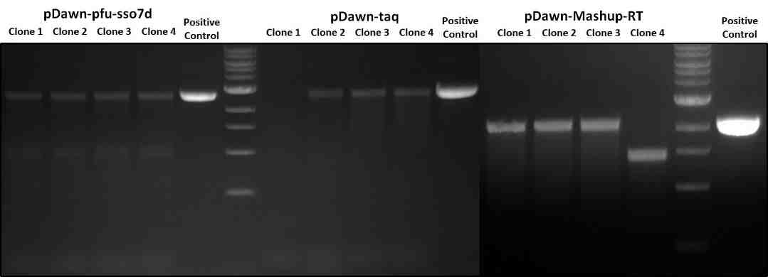
D
Phase 3
Optogenetic Molecular Biosynthesis (test of the new strains)
3 reagents detection system for SARS-Cov2
DNA polymerase
DNA polymerase
Reverse transcriptase
Alexander Klenov et al., 2020

Slide 12
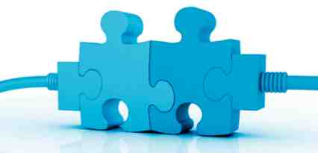
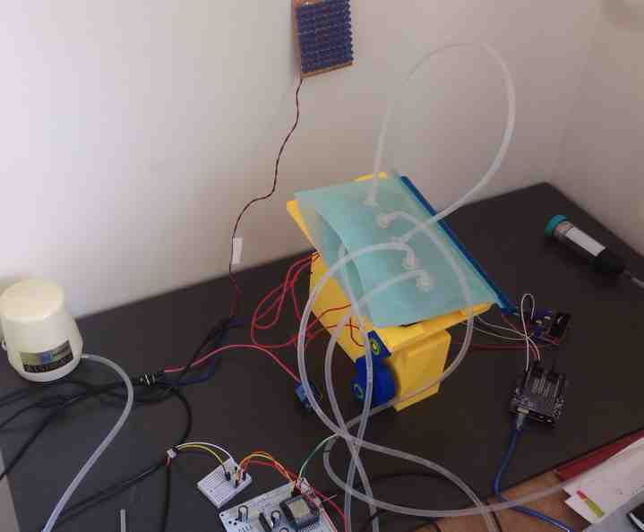
A
Phase 4
Product Design Early prototype
Standalone rocker

Slide 13
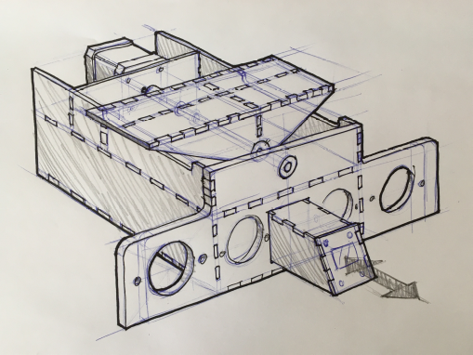
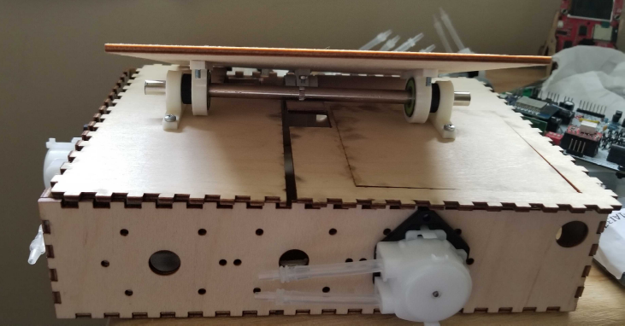
A
Phase 4
Product Design
Artist’s Concept Sketch
(Charlotte Vanhoutte, Brussels 2020)
Assembled plywood prototype with peristaltic pump

Slide 14
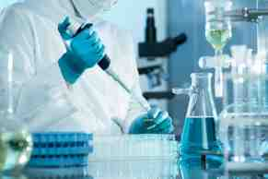
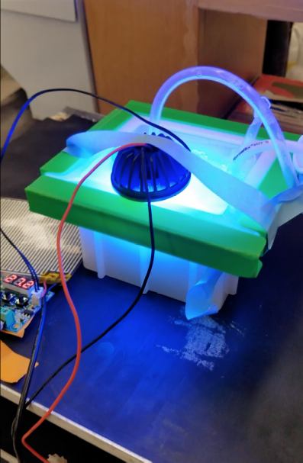
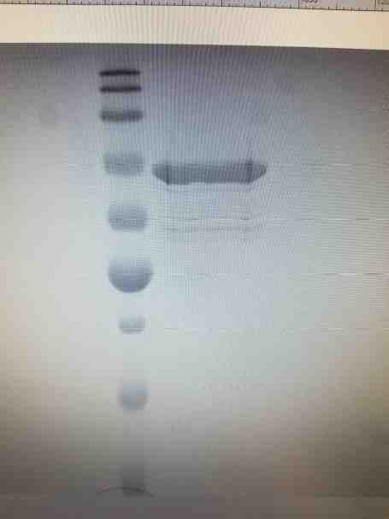
D
Phase 5
TESTING Proof of concept : Blue light protein induction and purification
(Standalone Testing)
Pfusso7d His6x
HiTrap NiNTA GE
SDS-PAGE 12%
Alexander Klenov (Pipette Jockey) et al., 2020 (in progress)

Slide 15
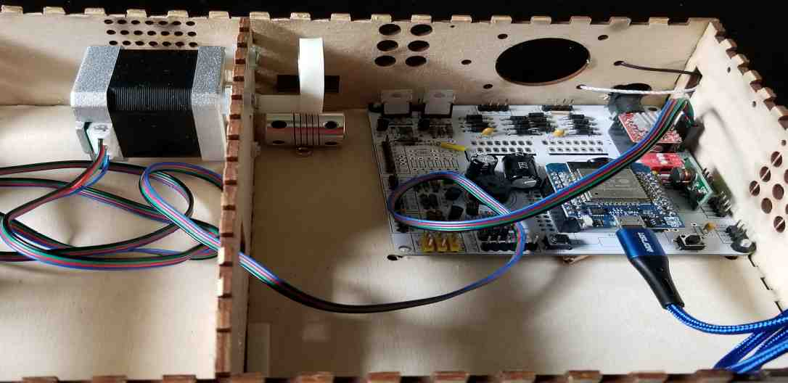
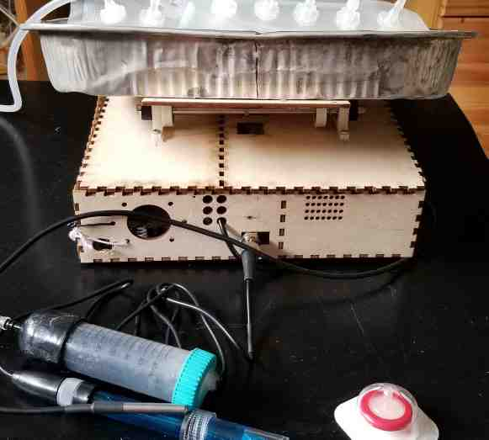
A
Phase 5
TESTING Assembly and systems integration
A
B
A) Inside the rocker showing motor, partial cam mechanism and main board
B) Rocker with platform, reusable culture vessel (bag) and sensors
(pH, temperature)

Slide 16
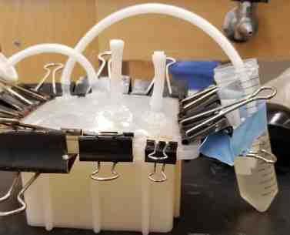
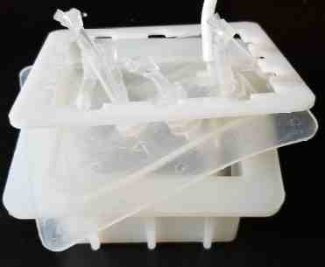
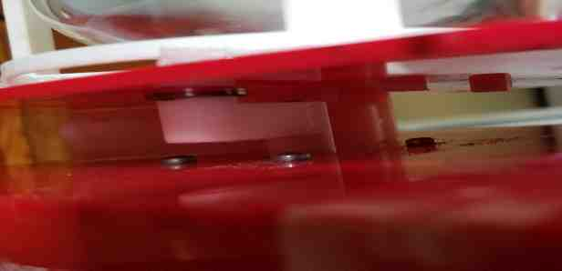
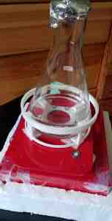
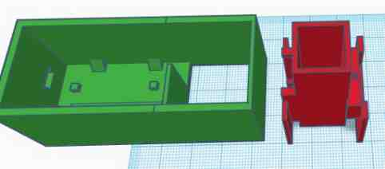
A
In progess
Optional and residual accessory submodules outcomes
Customized silicon vessel
Orbital shaker mechanism
Optical density unit
Exhaust air filter & Flow Cell

Slide 17
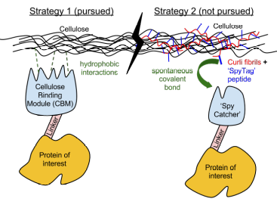
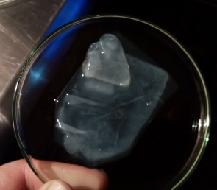
D
In progess satellite projects
Exploring alternative PROTEIN PURIFICATION methods (Proof of concept)
Exploration on Cellulose Binding Module for affinity chromatography
Isolated crystalline bacterial nanocellulose from axenic culture (Glyxon Biolabs, 2020)
Sirene : NO MORE METAL, nanocellulose affinity media
(In collaboration with Imperial College London & Nico Crudele)

Slide 18
D
SUMMARY
Three new strains controlled by an optogenetic switch that synthesize SARS Cov2 detection reagents. (2 DNApol, 1 Reverse transcriptase)
Several versions of the rocker one 3D printed and one laser cut, and one CNC prototypes. (1 liter media)
Several dedicated PCB capable of integrating multiple sensors and actuating heat, rocking, pumps and LED lights.
Basic software to remotely control operating functions and adjustment of multiple variables (temperature, pH, rocking, optical density and several peristaltic pumps)
Unit tested temperature control
Unit tested pH control
Unit tested grow flow cell for measuring optical density (un-calibrated)
IN PROGRESS
Full completion, assembly and integration of system
Calibration of some sensors
Finalized Optional sub-projects (Dissolved Oxygen monitoring)

Slide 19
Thank you!
A/D
SynBiosys
SBGH
Synthetic Biosystems Global Hub
+
+
Adrian Filips
Alexander (Sasha) Yakovlev
Nicolas Crudele
Adrian Jones
Vladyslav Boyko
Therese Schachner
Charlotte Vanhoutte
Alex Klenov
David J. Castillo
Daniel Zepeda (logistics)
Giulio Zappa (Università statale di Milano, Italy)
Tom Bishop (UC Davis)
Ottawa Bio Science
Pipette Jockey
Toronto
and many more volunteers…
Glyxon Biolabs
CDMX, Mexico
Special acknowledgment to :
Jenny Molloy Lab
http://specyal.com/diybio/bioreactor.html

Slide 20
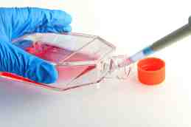
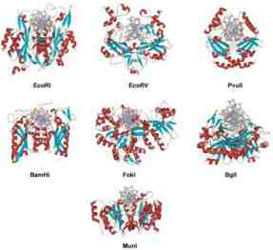
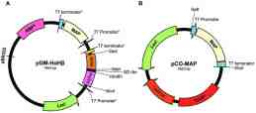
A
Long term implications of a DIY Bioreactor
The Here and now,
Tissue cultures
Insitu production of molecular reagents,
tissues, biomaterials
Modification
enzymes
This could overcome geographical barriers
and limited or expensive supply chains.
Vectors

Slide 21
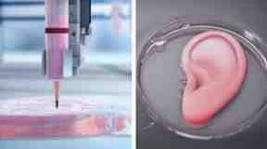
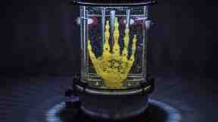
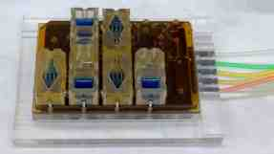
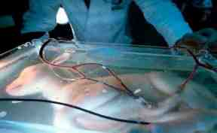
D
Long term implications of a DIY Bioreactor
The following next years…
Biofabrication 3D printing of organs
Biosynthesis of biocompatible scaffold
(polymers, bioplastics, etc)
Organoids
Bioreactor as
Facilitator or accelerator
Artificial womb

